Slide 1
Software Modularity

Slide 2

Modularity
Decomposing the project in modules at development time
Modules can be developed independently
@Dr. Ugrasen Suman, Professor, SCSIT, DAVV Indore (MP), India

Slide 3
Modularity
Big Ball of Mud
Modularity definitions
Modularity recommendations
  SOLID, Cohesion, Coupling, Connascence, Robustness, Demeter, Fluid interfaces
Modularity styles
  Layers
  Aspect Oriented decomposition
  Domain based decomposition
@Dr. Ugrasen Suman, Professor, SCSIT, DAVV Indore (MP), India

Slide 4
Modularity
Big Ball of Mud
Elements - Lots of entities intertwined
Constraints –None
Quality attributes - Time-to-market (short and early delivery) and Cost (cheaper)
High Maintenance costs
Low flexibility at some given point: At the beginning, it can be very flexible; After some time, a change can be dramatic
Throwaway code: quick prototype
Cut/Paste reuse
Bad code reproduced in lots of places
Anti-patterns and technical debt
@Dr. Ugrasen Suman, Professor, SCSIT, DAVV Indore (MP), India

Slide 5
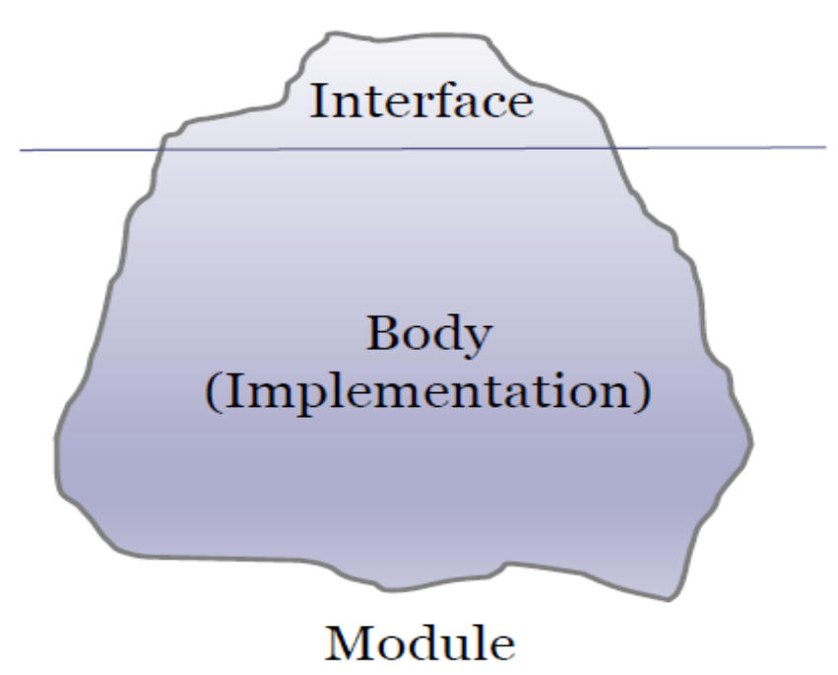
Modularity
Modularity definitions
Module is a piece of software the offers a set of responsibilities
  It makes sense at building time (not at runtime)
  Separates interface from body
Interface: Describes what is a module and How to use it?
Body: How it is implemented?
@Dr. Ugrasen Suman, Professor, SCSIT, DAVV Indore (MP), India

Slide 6
Modularity
Modularity recommendations
SOLID design principles
Cohesion
Coupling
Connascence
Robustness: Postel’s law
Demeter's Law
Fluid interfaces
@Dr. Ugrasen Suman, Professor, SCSIT, DAVV Indore (MP), India

Slide 7
Modularity
Modularity recommendations: SOLID design principles
SRP (Single Responsibility Principle)
  A module must have one responsibility
OCP (Open-Closed Principle)
  The module must adapt to new changes and Changes can be done without changing the module
LSP (Liskov Substitution Principle)
  Subtypes must follow supertypes contract
ISP (Interface Seggregation Principle)
  Clients must not depend on unused methods and it is better to have small and cohesive interfaces
DIP (Dependency Injection Principle)
  High-level modules should not depend on low-level modules, Both should depend on abstractions, Abstractions should not depend upon details.
@Dr. Ugrasen Suman, Professor, SCSIT, DAVV Indore (MP), India

Slide 8
Modularity
Modularity recommendations: Cohesion
Cohesion = Degree to which the elements of a module work together
It is recommended to have high cohesion
Levels of cohesion:
  Functional cohesion (best)
  Sequential cohesion
  Communicational cohesion
  Procedural cohesion
  Temporal cohesion
  Logical cohesion
  Coincidental cohesion (worst)
@Dr. Ugrasen Suman, Professor, SCSIT, DAVV Indore (MP), India

Slide 9
Modularity
Modularity recommendations: Coupling
Coupling = Degree of interdependence between software modules
Low coupling Improves modifiability
Types of coupling:
  Message coupling (best)
  Data coupling
  Stamp coupling
  Control coupling
  External coupling
  Common coupling
  Content coupling (Worst)
@Dr. Ugrasen Suman, Professor, SCSIT, DAVV Indore (MP), India

Slide 10
Modularity
Modularity recommendations: Connascence
Things that are born and grow together
A change in one requires others to be modified to maintain the system correct
  Indicates problems to change -affects modifiability
  A vocabulary to talk about coupling
  Combines coupling and cohesion
Types of connascence
Static = can be detected with static analysis
  Several components must agree with name, type, meaning, position, algorithm
Dynamic = detected at runtime
  (Order of execution, time of execution like race condition, values change together, reference to same variable etc.)
@Dr. Ugrasen Suman, Professor, SCSIT, DAVV Indore (MP), India

Slide 11
Modularity
Modularity recommendations: Robustness: Postel’s law
Postel’s law (1980), defined for TCP/IP
  Be liberal in what you accept and conservative in what you send
  Improve interoperability
    Send well formed messages
  Accept incorrect messages
Applications to API design
  Process fields of interest ignoring the rest
  Allows APIs to evolve later
@Dr. Ugrasen Suman, Professor, SCSIT, DAVV Indore (MP), India

Slide 12
Modularity
Modularity recommendations: Demeter's Law
Also known as Principle of less knowledge
Demeter System Law
  Units should have limited knowledge about other units
    Only units “closely” related to the current unit.
  Each unit should only talk to its friends
    "Don’t talk to strangers"
  Symptoms of bad design
    Using more than one dot...
      a.b.method(...)
      a.method(...)
@Dr. Ugrasen Suman, Professor, SCSIT, DAVV Indore (MP), India

Slide 13
Modularity
Modularity recommendations: Fluid interfaces
Improve readability and usability of interfaces
Advantages
  Can lead to domain specific languages
  Auto-complete facilities by IDEs
@Dr. Ugrasen Suman, Professor, SCSIT, DAVV Indore (MP), India

Slide 14
Modularity Styles
Layered arrangement of modules
Virtual machines
Aspect Oriented
Domain based
@Dr. Ugrasen Suman, Professor, SCSIT, DAVV Indore (MP), India

Slide 15
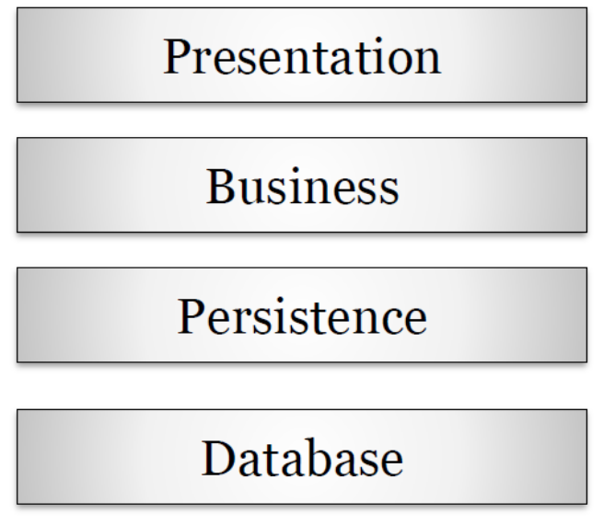
Modularity Styles
Layered arrangement of modules
Divide software modules in layers
Layers are ordered
Each layer exposes an interface that can be used by higher layers
Layering improves
  Reusability
  Testability
  States abstraction level
  Loose coupling
Variants:
  Virtual machines, APIs,
  3-layers, N-layers
@Dr. Ugrasen Suman, Professor, SCSIT, DAVV Indore (MP), India

Slide 16
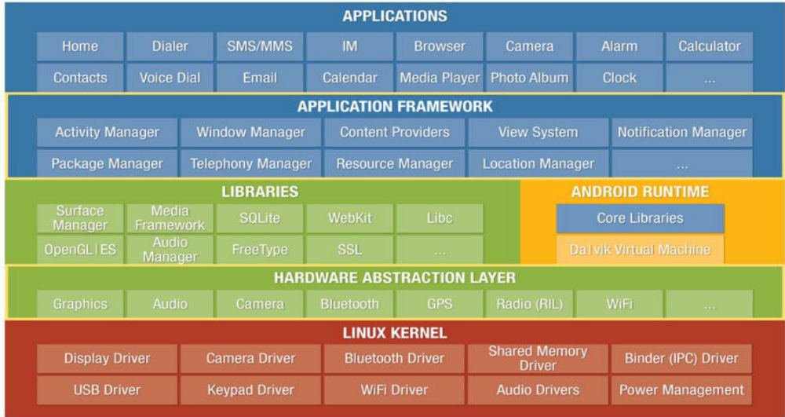
Modularity Styles
Layered arrangement of modules: Other Example
@Dr. Ugrasen Suman, Professor, SCSIT, DAVV Indore (MP), India

Slide 17
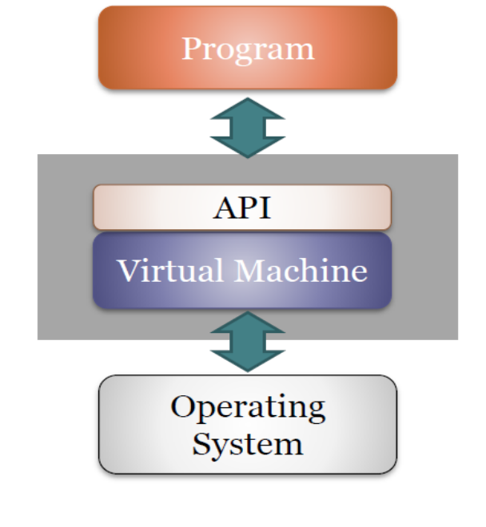
Modularity Styles
Virtual Machines (VM)
  Virtual machine = Opaque layer
Hides a specific OS implementation
One can only get Access through the public API
Advantages
  Portability
  Simplifies software development
  Higher-level programming
  Facilitates emulation
@Dr. Ugrasen Suman, Professor, SCSIT, DAVV Indore (MP), India

Slide 18
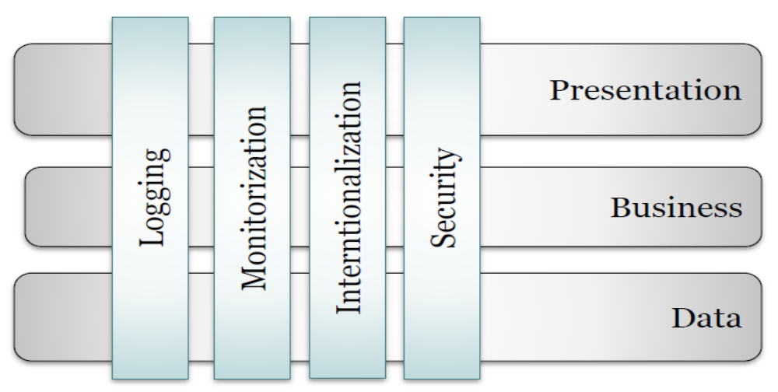
Modularity Styles
Aspect-Oriented
Aspects: Modules that implement crosscutting features
Crosscutting concern: Functionality that is required in several places of an application
Examples: logging, monitoring, i18n, security,...
@Dr. Ugrasen Suman, Professor, SCSIT, DAVV Indore (MP), India

Slide 19
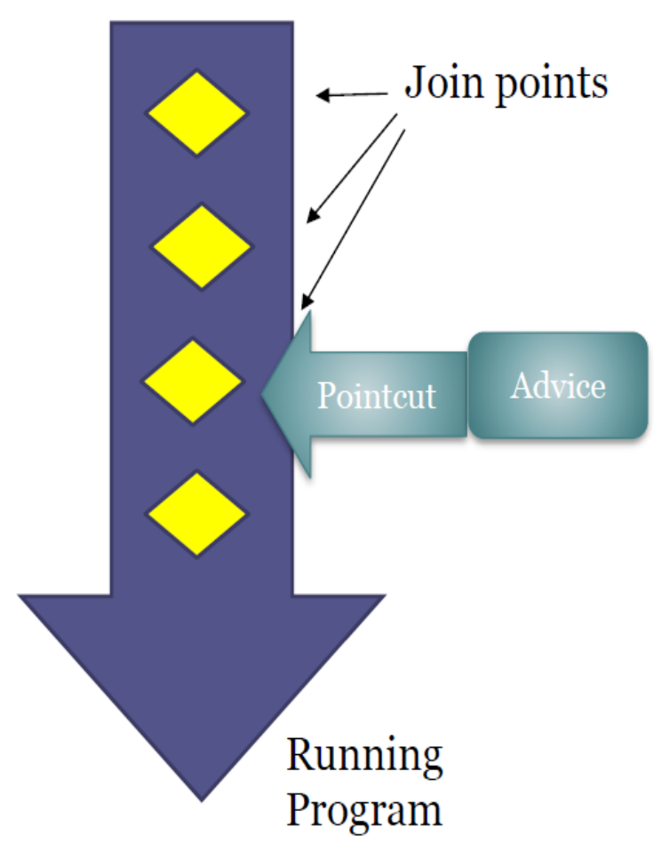
Modularity Styles
Aspect-Oriented
Join point: Point where an aspect can be inserted
Aspect contains:
Advice: defines the job of the aspect
Pointcut: where the aspect will be introduced
It can match one or more join points
@Dr. Ugrasen Suman, Professor, SCSIT, DAVV Indore (MP), India

Slide 20
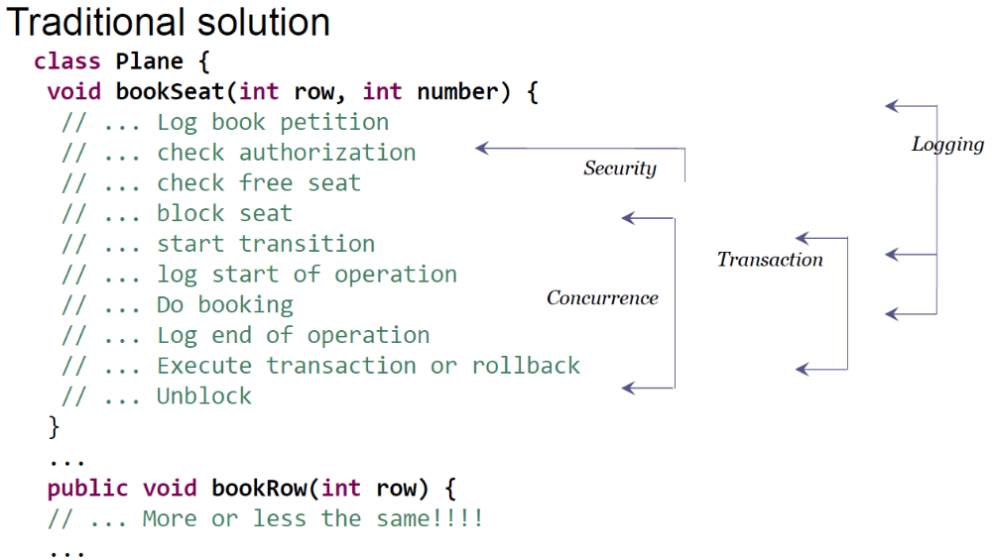
Modularity Styles
Aspect-Oriented
@Dr. Ugrasen Suman, Professor, SCSIT, DAVV Indore (MP), India

Slide 21
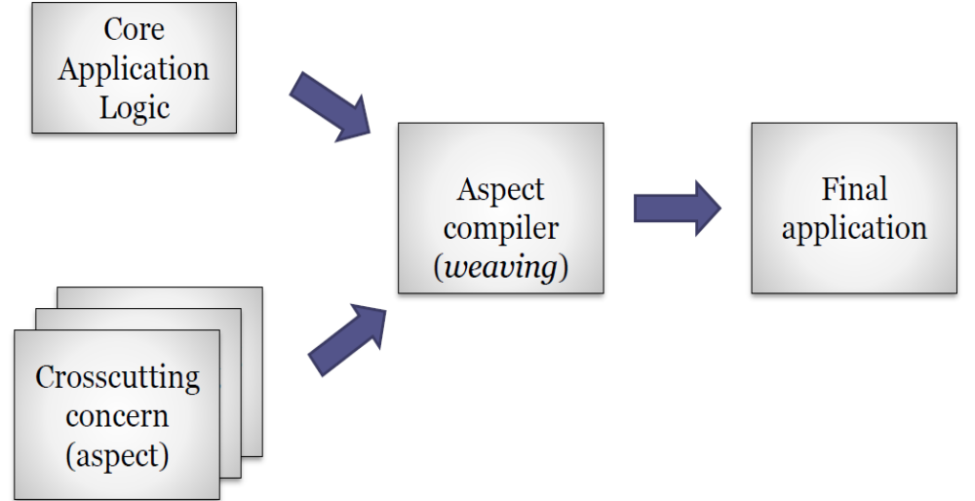
Modularity Styles
Aspect-Oriented Structure
@Dr. Ugrasen Suman, Professor, SCSIT, DAVV Indore (MP), India

Slide 22
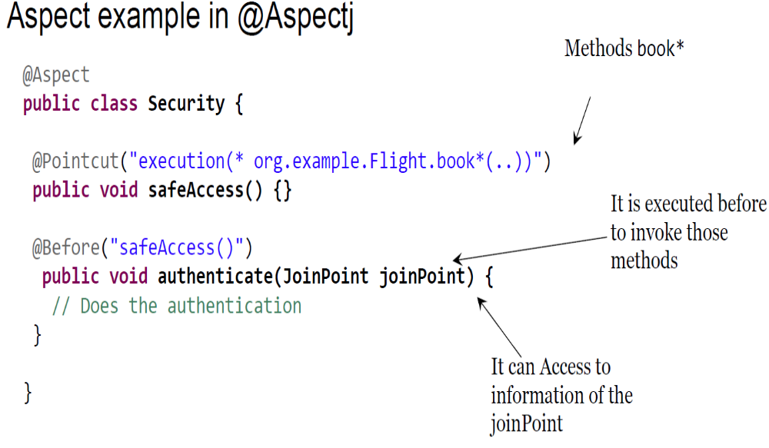
Modularity Styles
@Dr. Ugrasen Suman, Professor, SCSIT, DAVV Indore (MP), India

Slide 23
Modularity Styles
Domain based
Domain driven design
Hexagonal architecture
Data centered
Naked Objects
@Dr. Ugrasen Suman, Professor, SCSIT, DAVV Indore (MP), India

Slide 24
Modularity Styles
Domain based
Domain model is a clearly identified module separated from other modules
Domain centered application
  Application must adapt to domain model changes
No topological constraints
Domain model is formed by Context, Entities and Relationships
Advantages:
  Facilitates team communication,
  Reflects domain structure,
  Reinforce data quality & consistency
  and Facilitates system testing.
@Dr. Ugrasen Suman, Professor, SCSIT, DAVV Indore (MP), India

Slide 25
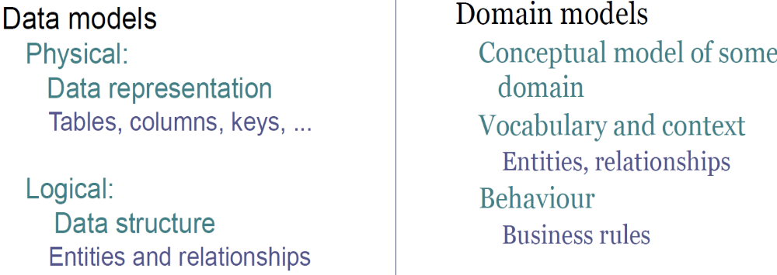
Modularity Styles
Domain based
Centered on the domain and the business logic
  Goal: Anticipate and handle changes in domain
  Collaboration between developers and domain experts
@Dr. Ugrasen Suman, Professor, SCSIT, DAVV Indore (MP), India

Slide 26
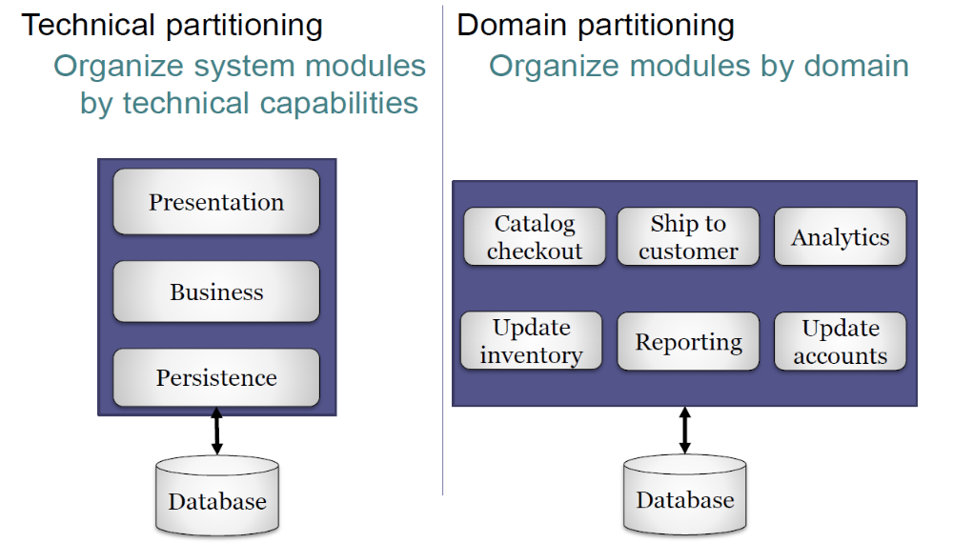
Modularity Styles
Domain based
@Dr. Ugrasen Suman, Professor, SCSIT, DAVV Indore (MP), India

